Slide 1


small language model for Sri Lankan legal application
25-26J-240

Slide 2


Supervisor
Supervisor

Slide 3


Fine-tuning an SLM to provide end-to-end, step-by-step guidance for resolving user problems in Sri Lankan Property Law and Family Law.
Information Technology
IT22177032 | Mathusigan E.S | 25-26J-240
07/01/2026
41

Slide 4

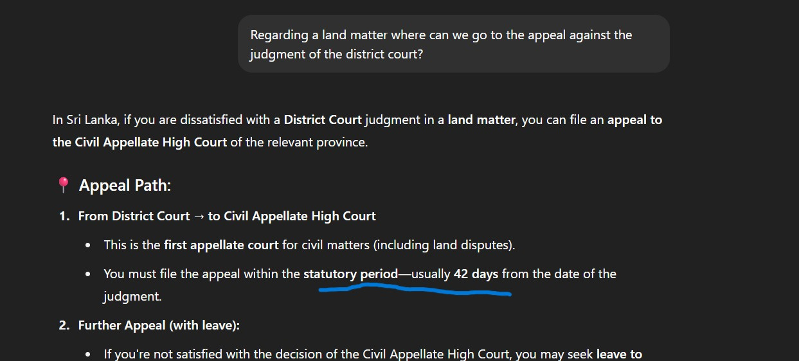

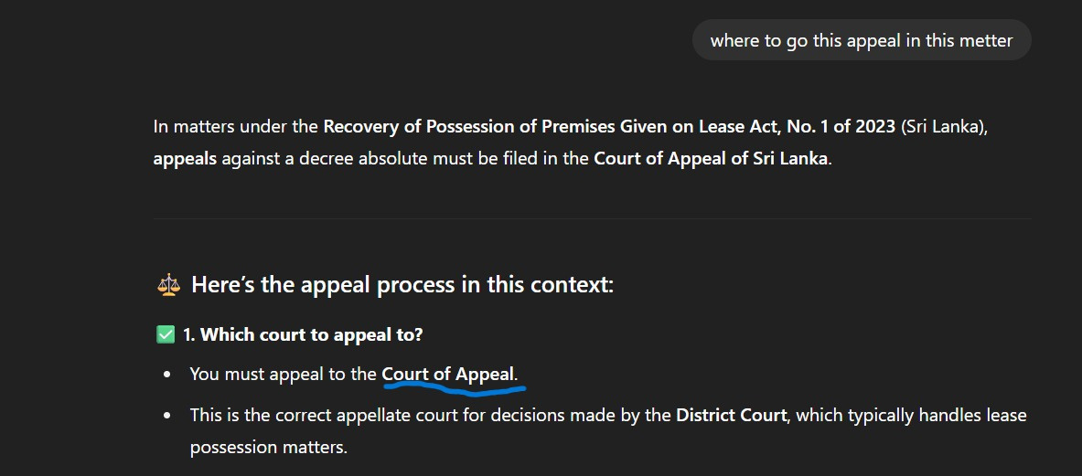
Law Recommendation system for user specially focus on labour and employment law
Problem Definition
Although Sri Lankan Property Law and Family Law are well documented in books and Acts, there is no Accurate AI-based system that provides reliable, step-by-step guidance tailored to real-world Sri Lankan legal problems. As a result, citizens facing land or family-related issues usually need to consult lawyers, which is time-consuming and costly. While general AI tools such as ChatGPT and Gemini can offer but it’s not accurate.
Solution Approach
How Problem Will Be Addressed
Domain-specific SLM fine-tuning
Agentic Rag architecture SLM approach
Rag architecture SLM approach
Agentic approach
User friendly validated Structured outputs
IT22177032 | Mathusigan E.S | 25-26J-240
07/01/2026
2

Slide 5
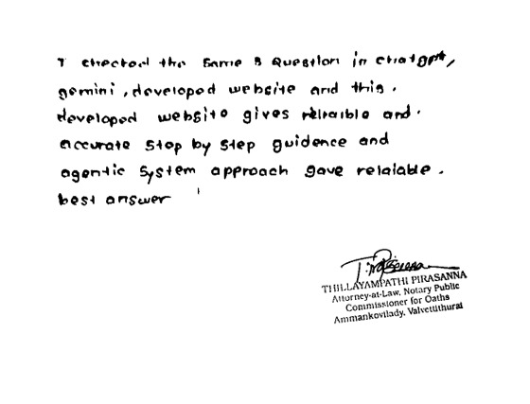
Law Recommendation system for user specially focus on labour and employment law
User Requirements
Legally Accurate Responses
Step-by-Step Legal Reasoning
Safe Usage: Prevents out-of-scope or unsafe legal advice
Accessible Interface: Usable by workers, students, and professionals
User feedback on prototype and Validate
IT22177032 Mathusigan E.S | 25-26J-240
07/01/2026
3

Slide 6
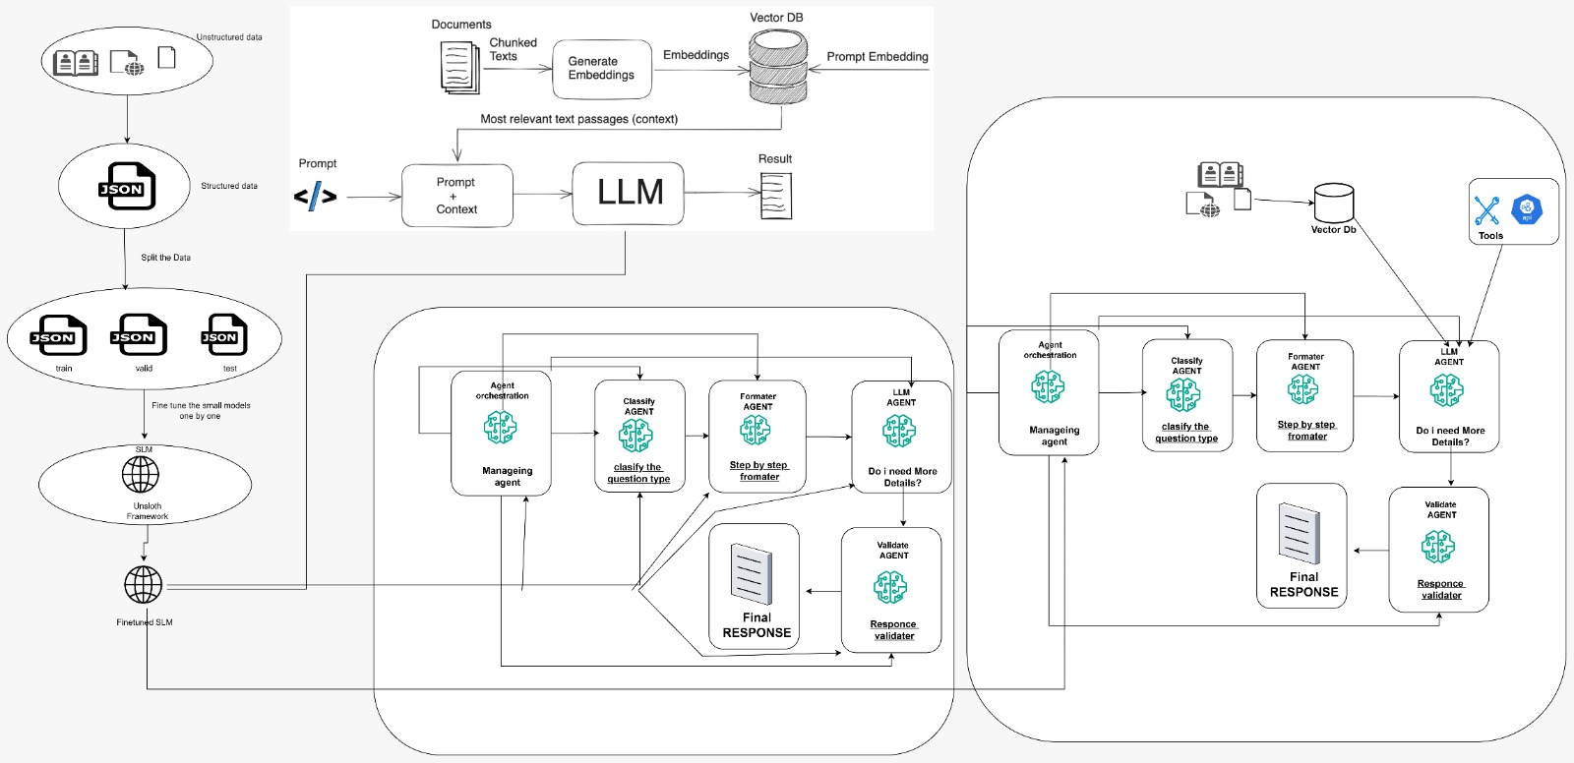
Design Excellence Architecture diagram
IT22177032 | Mathusigan E.S | 25-26J-240
07/01/2026
4

Slide 7

Using a Small Language Model to Templates Matching and Provide Recommendation
Information Technology
IT22030412 | A.Thuvaraga | 25-26J-240
07/01/2026
5

Slide 8
Law Recommendation system for user specially focus on labour and employment law
Problem Definition
Compression with ChatGPT
deed checking is currently done manually buy lawyers. It’s takes long time and may cause human errors and small mistakes such as missing sections, wrong clause , in order can make deed invalid there is no accurately specified automated system in sri lanka
I Uploaded Gifted Deed and compared
1)Stamp Duty
MY: ✅ CORRECT - Critical Issue
Finding: "Signature block and notary's attestation list both principal and attorney as executants"
ChatGPT: ❌ MISSED
Not specifically identified
2) Attorney as Executant
MY: ✅ CORRECT - Critical Issue
Finding: "Attorney (YOGASRI GANESHAN) is listed as an 'executant' who signed the deed“
ChatGPT: ❌ MISSED COMPLETELY
How Problem Will Be Addressed
Deed type classification
Agentic approach
Algorithm writed inside the Slm
Issue detection + severity
User friendly validated Structured outputs
Solution Approach
IT22030412 | A.Thuvaraga | 25-26J-240
07/01/2026
6

Slide 9
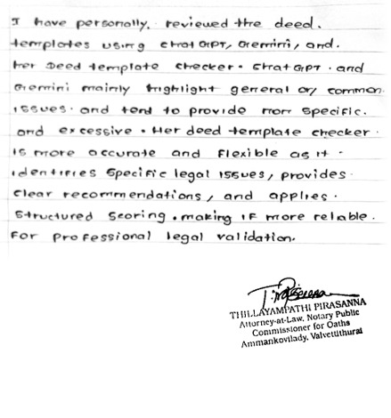
Law Recommendation system for user specially focus on labour and employment law
User Requirements
Legally Accurate Responses
Legal entity extraction
Issue detection + severity
Accessible Interface: students, and Lawyers
User feedback on prototype and Validate
IT22030412 | A.Thuvaraga | 25-26J-240
7
07/01/2026

Slide 10
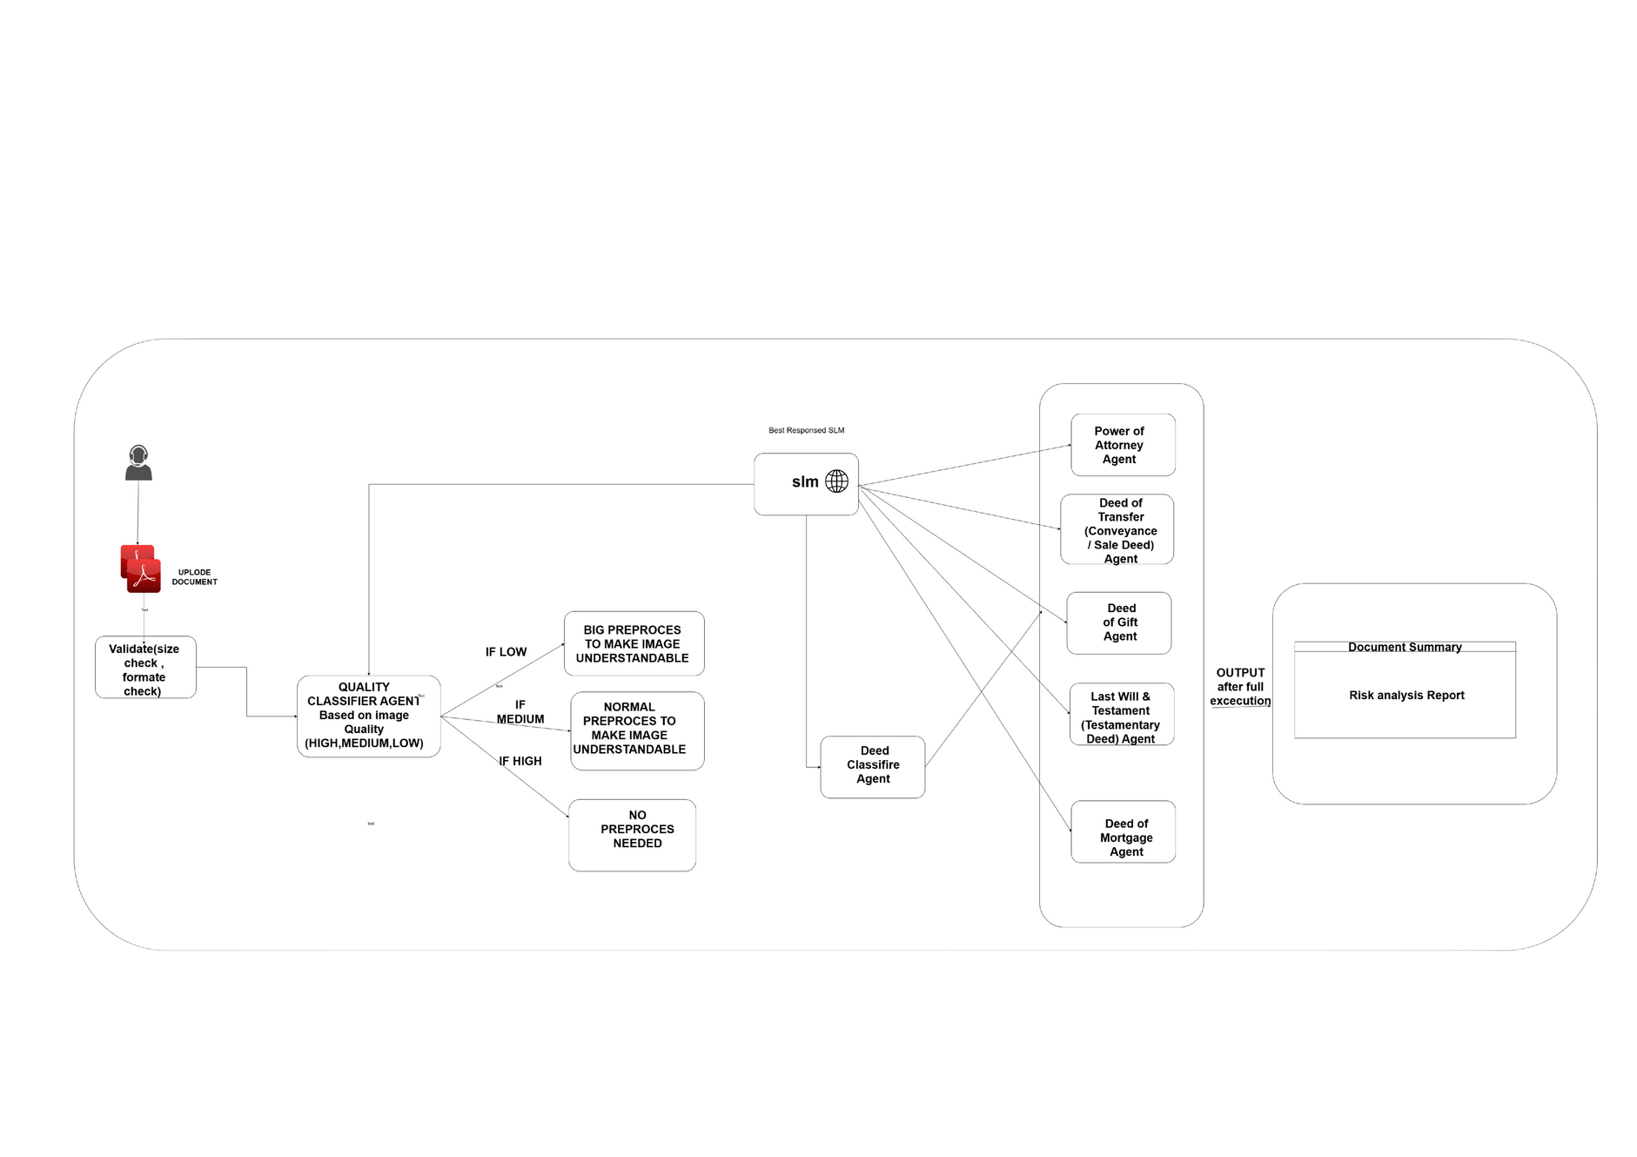
Design Excellence Architecture diagram
.
IT22030412 | A.Thuvaraga | 25-26J-240
07/01/2026
8

Slide 11

Law Recommendation system for user specially focus on labour and employment law
Information Technology
IT22322326 | Niruththika E| 25-26J-240
07/01/2026
9

Slide 12

Law Recommendation system for user specially focus on labour and employment law
Problem Definition
Proven Gap
General-purpose LLMs hallucinate legal information
Responses lack Sri Lankan legal grounding
No linkage between laws and court cases
Unsafe for real-world legal decision-making
Proven incorrect responses verified by a legal professional
No fine-tuned LLM for Sri Lankan labour law
Lack of RAG integration in existing systems
Poor handling of natural language legal queries
No scenario-based legal recommendations
Limited tools for both legal and non-legal users
Solution Approach
How Problem Will Be Addressed
Domain-specific LLM fine-tuning
Hybrid Retrieval-Augmented Generation (RAG)
Law-only knowledge enforcement
Evidence retrieval from verified legal sources
Structured, citation-backed outputs
Production-ready backend architecture
Eliminates LLM hallucinations using RAG
Grounds answers in verified legal documents
Ensures Sri Lanka–specific legal accuracy
Provides scenario-based recommendations
Democratizes access to labour law knowledge
IT22322326 | Niruththika E | 25-26J-240
07/01/2026
10

Slide 13
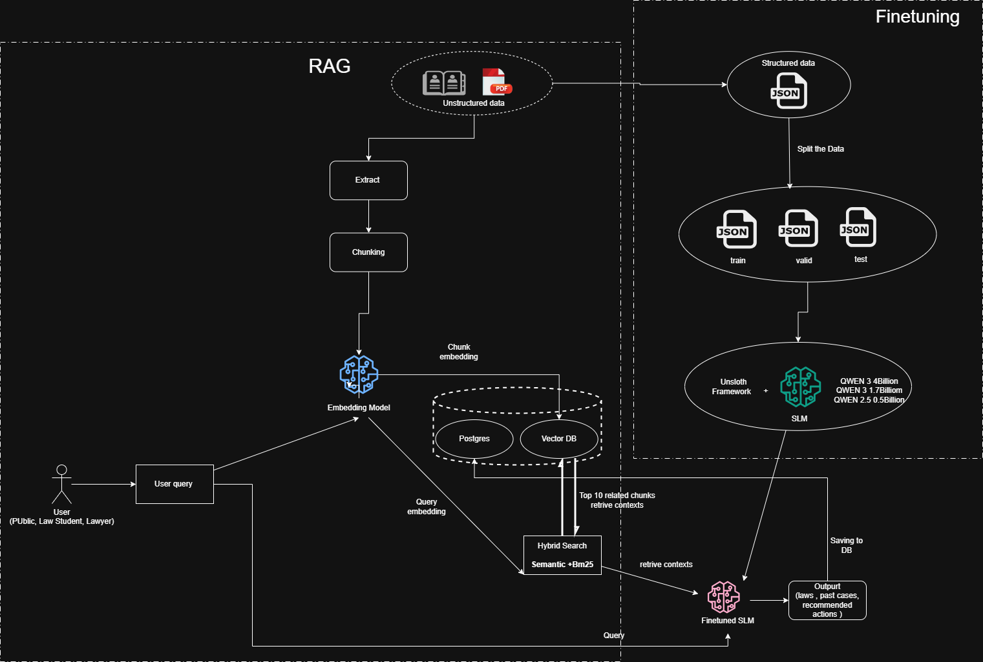
Design Excellence Architecture diagram
IT22322326 | Niruththika E | 25-26J-240
07/01/2026
11

Slide 14
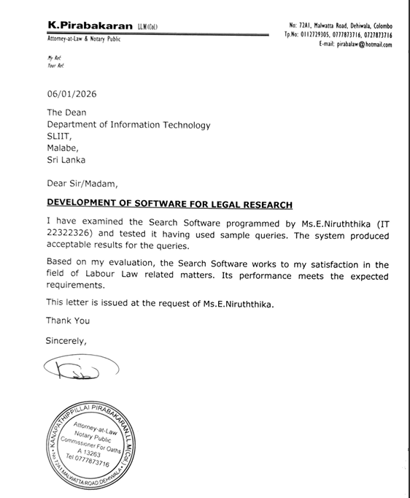
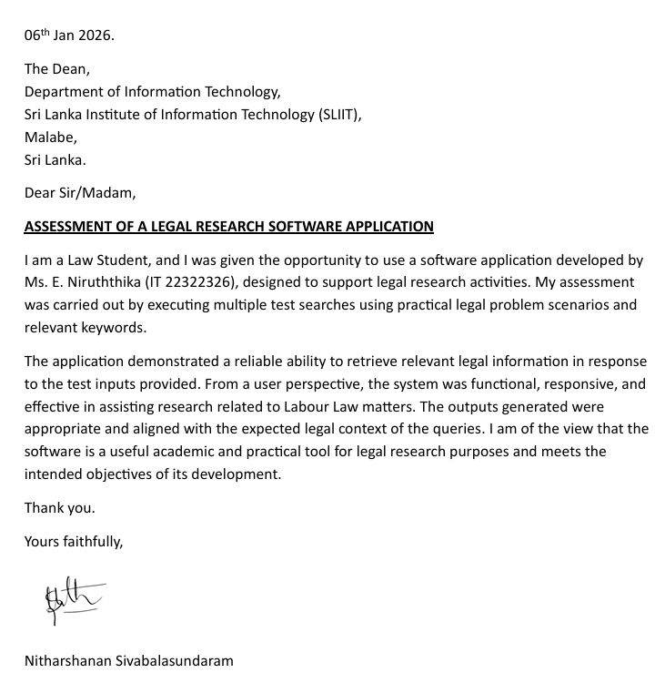
Law Recommendation system for user specially focus on labour and employment law
User Requirements
Functional Requirements
Natural language legal query processing
Labour & employment law scope enforcement
Semantic search over legal documents
Law & case citation generation
JSON-structured responses for frontend use
Fast and scalable backend API
Accurate Legal Guidance: Sri Lanka–specific labour & employment law
Evidence-Based Answers: Laws and past court cases with citations
Safe Usage: Prevents out-of-scope or unsafe legal advice
Accessible Interface: Usable by workers, students, and professionals
Design Excellence and contribution
User feedback on prototype and Validate
Novel: Fine-tuned Small Language Model for Sri Lankan labour law
Advanced NLP: Qwen3-4B + LoRA fine-tuning
Hybrid AI: Fine-tuned LLM combined with RAG
Safety-Aware: Explicit out-of-scope detection
Cost-Efficient: CPU-based deployment using quantized models
Improve accuracy, optimize deployment, implement admin panel, and complete full system integration
IT22322326 Niruththika E | 25-26J-240
07/01/2026
12

Slide 15
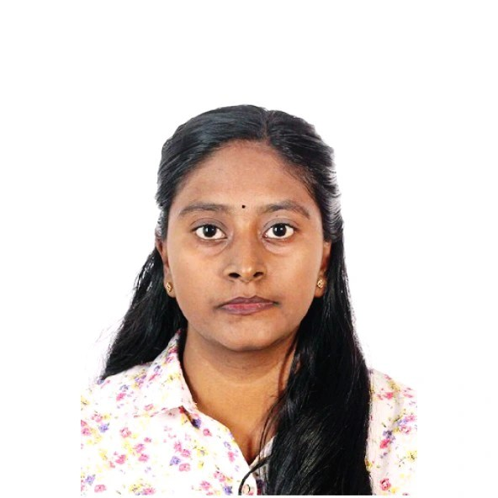
Judgment prediction based on past case studies regarding criminal cases
Information Technology
IT22049322 | Abiramy T| 25-26J-240
07/01/2026
13

Slide 16
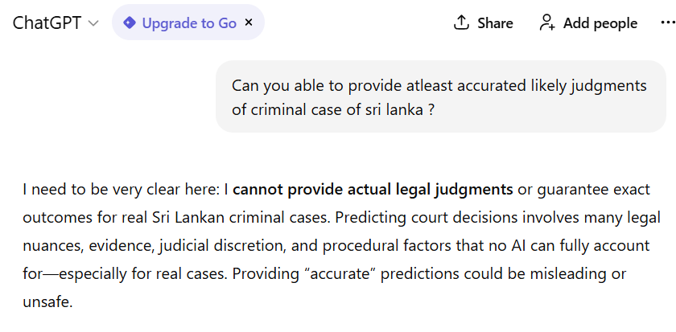
Sri Lankan Criminal Judgment Prediction
Problem Definition
Sri Lankan criminal judgments contain rich legal reasoning on evidence evaluation, sentencing principles, and judicial discretion. However, there is no AI-based decision-support tool designed for legal professionals to analyze and predict judgment outcomes using structured criminal case facts. General AI tools such as ChatGPT and Gemini can provide general legal explanations, but they are not trained specifically on Sri Lankan criminal judgments and do not follow local judicial reasoning or sentencing patterns.
Solution Approach
Domain-Specific Legal AI Model
A fine-tuned BERT-based model trained exclusively on Sri Lankan criminal judgments, ensuring relevance to local law.
Fact-Oriented Case Representation
Criminal case details (offence, evidence, witnesses, medical findings, arguments) are structured to mirror judicial fact summaries.
Multi-Class Judgment Prediction
Predicts realistic legal outcomes such as acquittal, fines, imprisonment ranges, life imprisonment, and death penalty.
Prototype as a Legal Research Tool
Designed for law students, legal researchers, and practitioners, not for general public legal advice.
Explainable Outputs
Provides both the predicted judgment and the generated legal narrative, supporting interpretability.
IT22049322 | Abiramy T| 25-26J-240
07/01/2026
14

Slide 17
Design Excellence / Contribution
Domain-specific legal AI solution tailored for Sri Lankan criminal judgments.
Introduced a fact-based judgment prediction approach, avoiding court, judge, or procedural bias.
Effective use of fine-tuned BERT model for capturing legal context and sentencing patterns.
Designed a modular and scalable architecture (Frontend, API, Prompt Builder, Model).
Implemented multi-class judgment outcome prediction beyond simple guilty/not guilty.
User Feedback on Prototype
The system is very user-friendly and easy to understand.
The inputs resemble real criminal case facts used in judgments.
Prediction results are clear and meaningful.
Helpful for legal education and research purposes.
The interface is simple and avoids unnecessary legal complexity.
IT22049322 | Abiramy T| 25-26J-240
07/01/2026
15

Slide 18
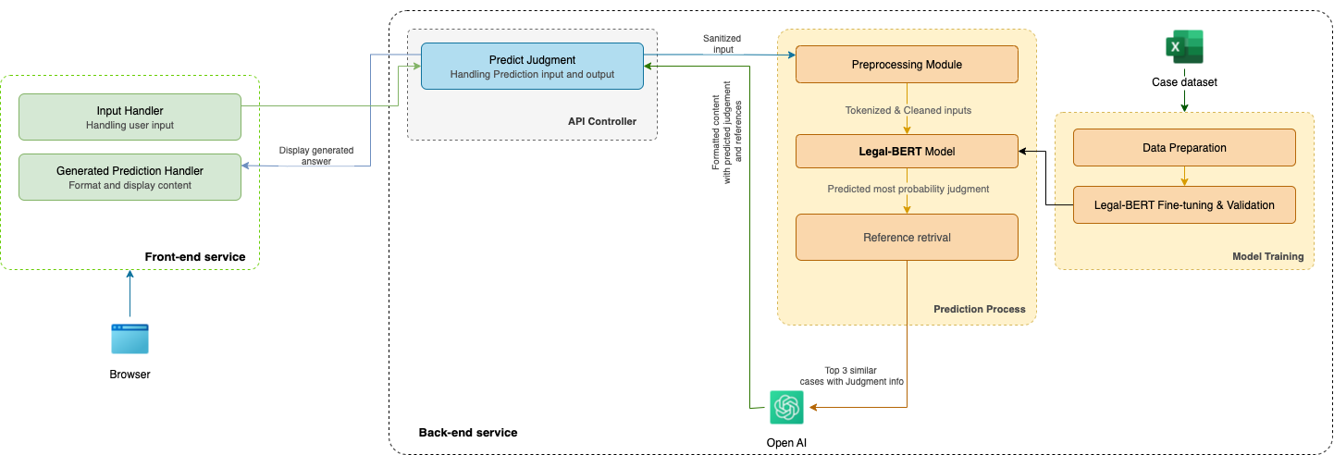

Design Excellence Architecture diagram
IT22049322 | Abiramy T| 25-26J-240
16

Slide 19




Commercialization/Sustainability of Solution
Market Size
Custom Persona
Sri Lanka’s complex and evolving labour laws create strong demand for an AI-driven, accurate legal recommendation system.
The platform serves lawyers, businesses, government bodies, courts, universities, and the general public.
Monetization includes subscriptions, government licenses, freemium upgrades, API access, and custom enterprise services.
What makes it unique
Cost Recovery
Designed for Sri Lankan labour law with easy expansion to other legal domains, jurisdictions, and white-label deployments.
A fine-tuned small language model with RAG delivers exact law sections, enactment years, scenarios, and case references.
6/1/2026
17

Slide 20

Thank You

